Slide 1
Empirical Rule (68-95-99.7%)
Data with symmetric bell-shaped distribution has the following characteristics.
P.148
13.5%
13.5%
68%
Z (The Standard Normal Distribution)
4
3
2
1
0
1
2
3
4
About 68% of the data lies within 1 standard deviation of the mean
About 95% of the data lies within 2 standard deviations of the mean
About 99.7% of the data lies within 3 standard deviations of the mean
Notes:
This type of distribution will be studied in much more detail in later chapters.

Slide 2
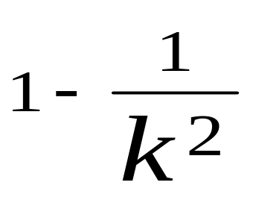
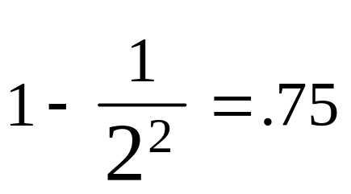
Chebyshev’s Theorem
For any set of observations (distributions), the proportion of values that lie within k standard deviations of the mean is at least:
k is the number of standard deviations, not the standard deviation.
Notes:
Allows us to determine the minimum percentage of values that lie within a specified number of SD’s from the mean. The importance of this rule is that the distibution can have any shape, not just normal.

Slide 3
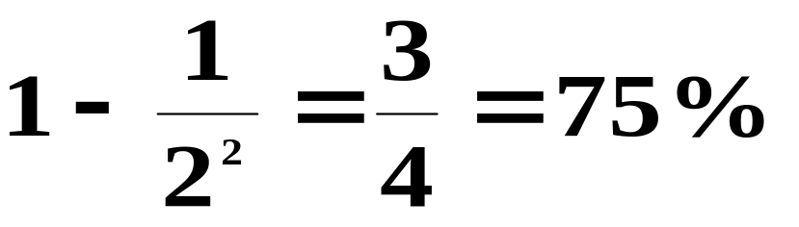
CHEBYSHEV'S THEOREM for k = 2
According to Chebyshev’s Theorem, at least what fraction of the data falls within “k” (k = 2) standard deviations of the mean?
At least:
of the data falls within 2 standard deviations of the mean.

Slide 4
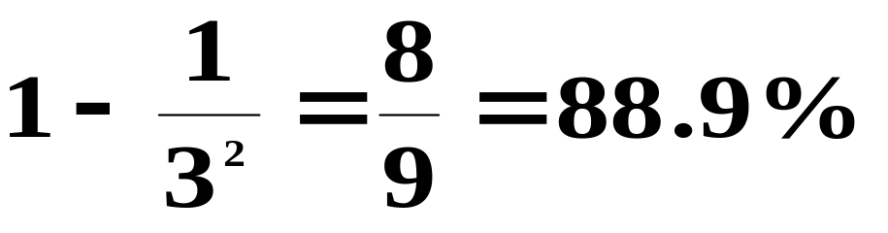
CHEBYSHEV'S THEOREM for k = 3
According to Chebyshev’s Theorem, at least what fraction of the data falls within “k” (k = 3) standard deviations of the mean?
At least:
of the data falls within 3 standard deviations of the mean.

Slide 5
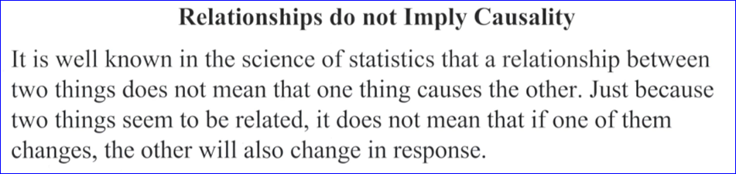
Regression Analysis
Least Squares Regression. Creating a mathematical equation by minimizing the sum of squares of the perpendicular distances between the actual Y values and the predicted value of Y.

Slide 6
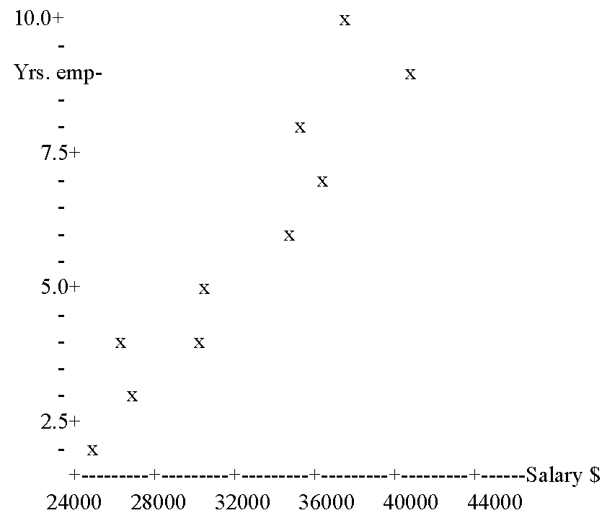
Scatter Plot. A graph that shows paired data, rather than just data in classes like a histogram. The data shows the correlation between two variables.
The resulting equation that models the data takes on the standard algebraic form of Y = mx +b.
Notes:
For pairwise data.

Slide 7
Regression Analysis
Simple (Linear) Regression. A statistical technique used to develop the mathematical linear relationship between one independent variable (predictor) and one dependent variable (response).
The resulting equation that models the data takes on the standard algebraic form of Y = mx +b.
When To Use. Use simple regression when the relationship between independent and dependent variables is approximately linear for the desired “interval of analysis”.
Notes:
When not to use. For example, a child’s height changes in an approximately linear fashion until they reach the age of 14, after which the the height changes to ln form.

Slide 8
Correlation Analysis
Correlation. A relationship between 2 variables.
Correlation Coefficient (R). A measure of the strength and direction of the linear relationship between two variables.

Slide 9
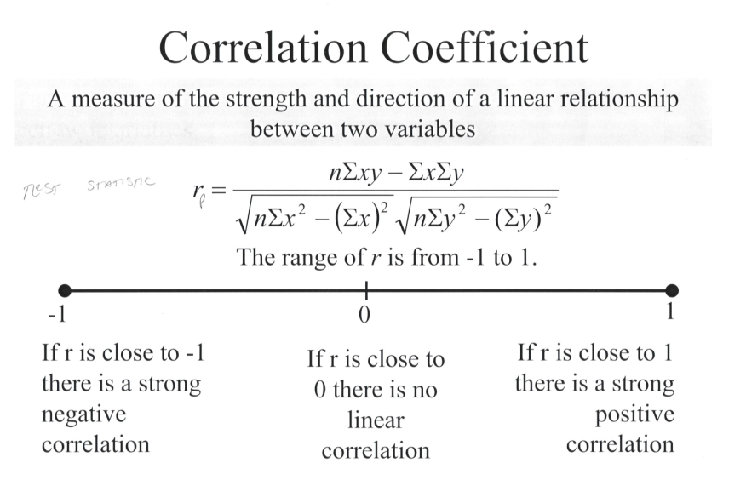
r

Slide 10
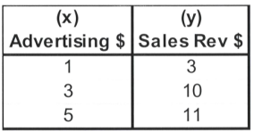
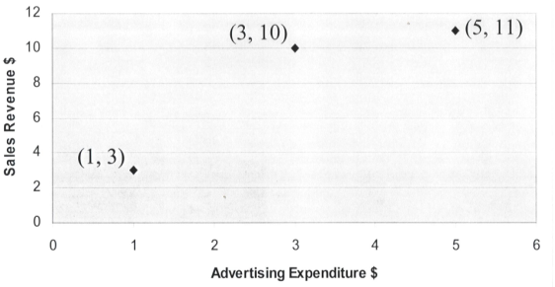

Slide 11
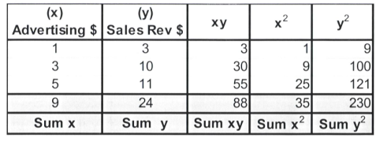
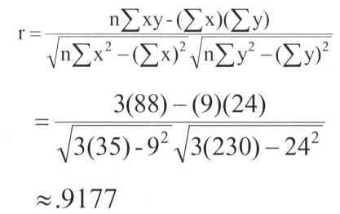

Slide 12
